Slide 1
Binomial Queues
By Abdul Imran
&
Manny Negrete

Slide 2
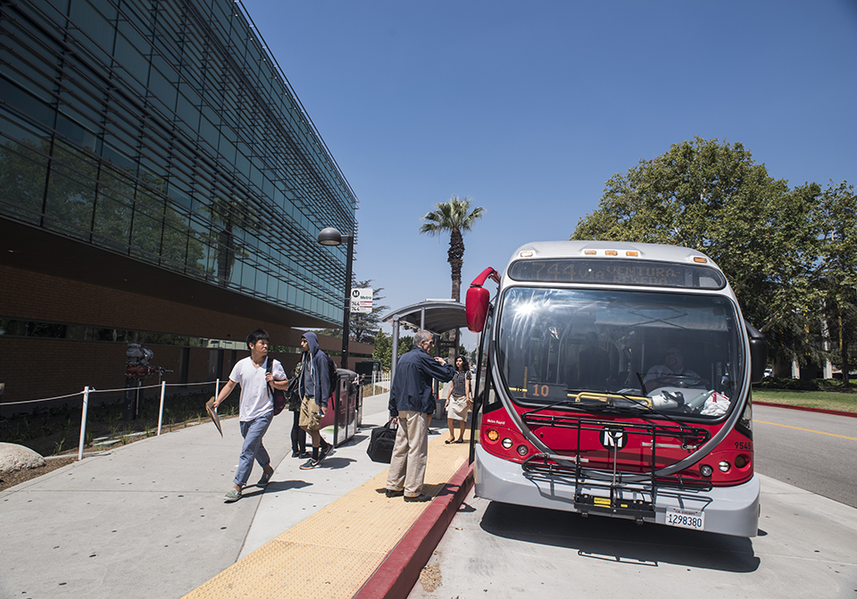
CSUN Shuttles
Prioritizing Passenger Loads: Discover how our code efficiently handles shuttle stop prioritization based on passenger loads.
Core Algorithms: We'll explore the essential algorithms for inserting, deleting, and merging priority elements within the code.
Unlock Efficiency: Uncover how binomial heaps are the key to streamlining your shuttle stop logistics and ensuring timely service to passengers.

Slide 3
Binomial Queues
Binomial queues are a collection of heap-ordered trees. Each of the heap-ordered trees is a binomial tree with the following constraints:
There is at most one binomial tree of every height.
A binomial tree of height 0 is a one-node tree; a binomial tree, Bk, of height k is formed by attaching a binomial tree, Bk−1, to the root of another binomial tree, Bk−1.

Slide 4
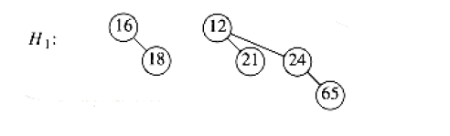
Binomial Queues
A binomial queue consisting of six elements with two binomial trees B1 and B2

Slide 5
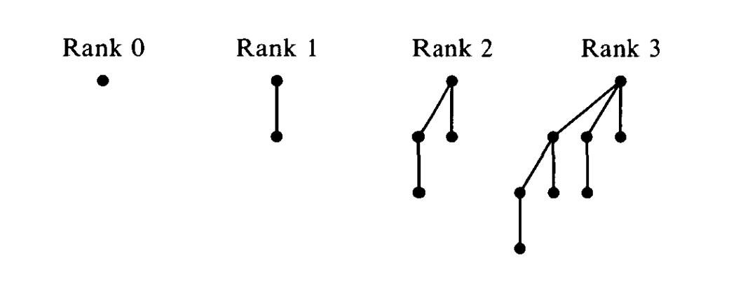
Binomial Queues
Binomial Queue with ranks from 0 to 3

Slide 6
Properties of Binomial Queues
A binomial tree B_{k}, consists of a root with children B₀, B₁,…, B_{k−1}.
Binomial trees of height k have exactly 2^{k} nodes
A priority queue of any size can be represented by a collection of binomial trees. For instance, a priority queue of size 13 could be represented by B₃, B₂, B₀ ( 13=2³+2²+2⁰). Thus, we can write this representation as 1101, which represents 13 in binary and the fact that B₃, B₂, B₀ are present and B₁ is not.

Slide 7
2. Datasets:
Where did you collect the dataset ?
Data set was published through a Google form then the data was collected.
What are characteristics of the samples ?
Distribution Across Hours: The samples are distributed across the time slots from 8 am to 9 pm.
Location Preference: Responses primarily indicated that majority of the students have their classes in Jacaranda Hall due to the large number of computer science students among the respondents. Other halls where classes were held include Cypress Hall, Live Oak Hall, Magnolia Hall, Bayramian Hall, Valera Hall, Chaparral Hall, Eucalyptus Hall, and Sierra Hall.
Number of Classes: Each respondent has a varying number of classes throughout the day.
Names: The dataset contains a diverse set of names from respondents who participated in the survey.

Slide 8
Time/Hall | Jacaranda Hall | Chaparral Hall | Bayramian Hall | Cypress Hall | Live Oak Hall | Magnolia Hall | Valera Hall | Eucalyptus Hall | Sierra Hall
8 am | 3 | 0 | 0 | 1 | 0 | 1 | 0 | 0 | 0
9 am | 3 | 4 | 1 | 0 | 1 | 1 | 1 | 0 | 0
10 am | 5 | 0 | 2 | 2 | 4 | 0 | 0 | 1 | 0
11 am | 5 | 2 | 0 | 2 | 1 | 1 | 0 | 0 | 1
12 pm | 5 | 0 | 1 | 0 | 0 | 0 | 1 | 0 | 1
1 pm | 9 | 0 | 0 | 4 | 2 | 1 | 0 | 1 | 1
2 pm | 7 | 1 | 2 | 2 | 2 | 0 | 2 | 0 | 1
3 pm | 3 | 0 | 0 | 3 | 1 | 3 | 2 | 0 | 1
4 pm | 5 | 0 | 1 | 1 | 2 | 2 | 1 | 0 | 0
5 pm | 0 | 1 | 1 | 0 | 1 | 0 | 0 | 0 | 0
6 pm | 0 | 1 | 0 | 0 | 1 | 1 | 0 | 0 | 0
7 pm | 2 | 0 | 0 | 1 | 1 | 0 | 0 | 1 | 1
8 pm | 1 | 0 | 1 | 0 | 0 | 0 | 0 | 0 | 0
9 pm | 1 | 0 | 0 | 0 | 0 | 0 | 0 | 0 | 0

Slide 9

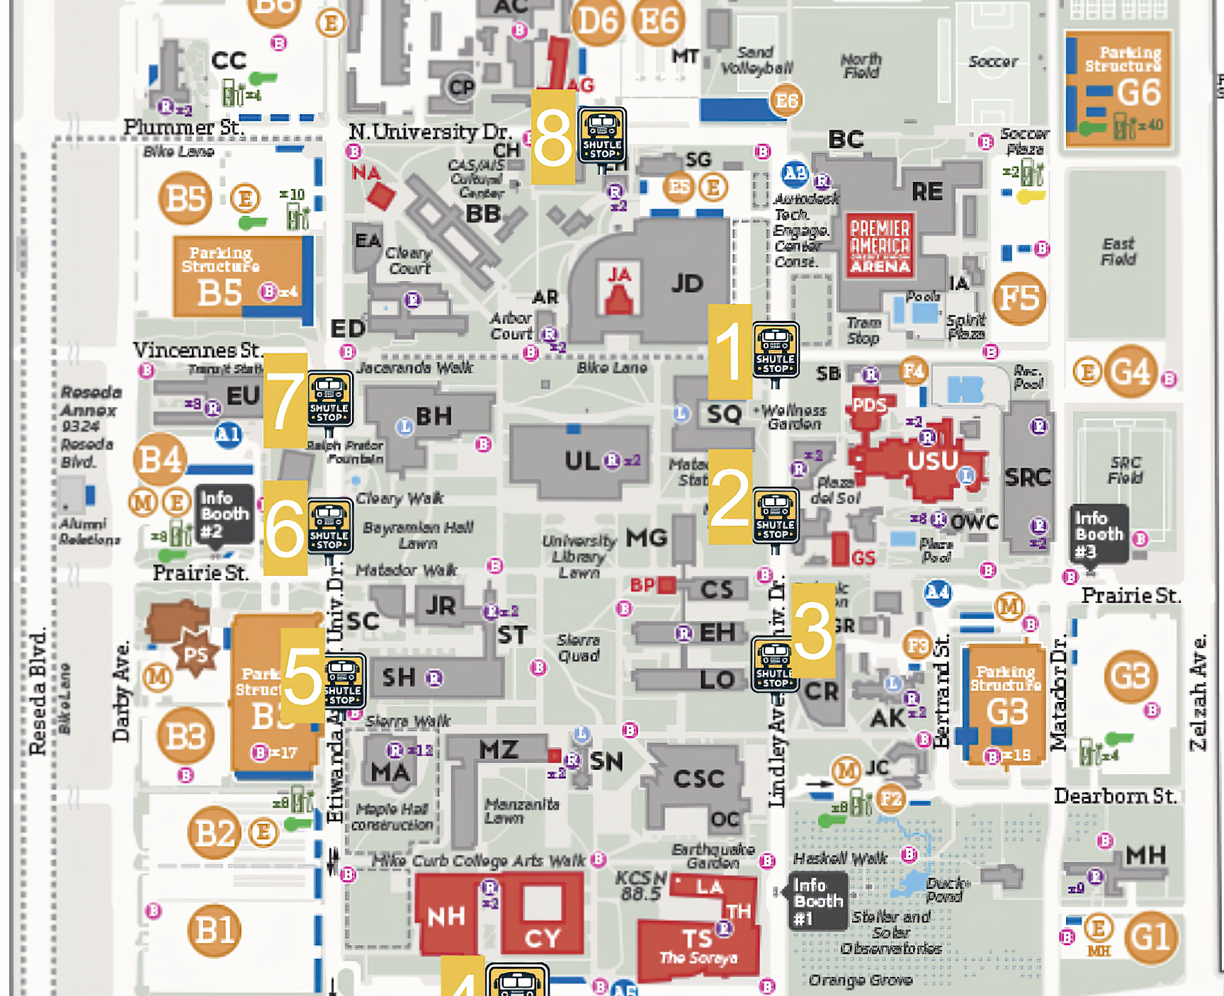
Shuttle Stops
*Figure depicts a CSUN campus map with marked shuttle stops, numbered in the order the shuttle will travel to them
Map displays designated shuttle stops.
Shuttle route: Stop 1 through Stop 8.
Arrival frequency: Approximately once an hour.
Boarding time: 3-10 minutes (varies based on student count).

Slide 10
3. Methodologies/algorithms:
Binomial Queues were utilized to streamline and optimize shuttles
Other key algorithms/data structures
Linkedlists
Heap Operations
Node Reversals (aka node deletion)

Slide 11
Pseudocode
# Create a ShuttleScheduler instance for scheduling shuttle stops
scheduler = new ShuttleScheduler<ShuttleStop>()
# Define halls with varying passenger loads
hallname = new Hall("hallname", #number of students)
cypressHall = new Hall("Cypress Hall", 50)
# Create shuttle stops based on the halls they serve
stop1 = new ShuttleStop(1)
stop1.addHall(hallname)
# Insert shuttle stops into the scheduler
scheduler.insert(stop1)
# Send shuttles to stops with the most passengers first
while not scheduler.isEmpty():
maxStop = scheduler.deleteMax()
print("Sending shuttle to: " + maxStop)?

Slide 12
4. Results of Shuttle Scheduling Algorithm
Efficiently scheduling shuttles to cater to stops with the highest passenger loads first using Binomial Queues.
Dataset: Different shuttle stops and the halls they serve with varying passenger loads.

Slide 13
Example Results
Example Result 1:
Shuttle Stop 5 Details:
Total Passengers: 50
Halls Served: Sierra Hall
This stop had the highest passenger load, showcasing the efficiency of our algorithm in prioritizing it.
Example Result 2:
Shuttle Stop 7 Details:
Total Passengers: 40
Halls Served: Bayramian Hall and Eucalyptus Hall
Despite serving two halls, the combined passenger load made this the second priority for our shuttles.

Slide 14
5. Contributions:
Our team has applied the concept of binomial queues to optimize CSUN shuttles on campus based on student schedules.

Slide 15

Big O Notation
# Create a ShuttleScheduler instance for scheduling shuttle stops
scheduler = new ShuttleScheduler<ShuttleStop>()
# Define halls with varying passenger loads
hallname = new Hall("hallname", #number of students)
# Create shuttle stops based on the halls they serve
stop1 = new ShuttleStop(1)
stop1.addHall(hallname)
# Insert shuttle stops into the scheduler
scheduler.insert(stop1)
# Send shuttles to stops with the most passengers first
while not scheduler.isEmpty():
maxStop = scheduler.deleteMax()
print("Sending shuttle to: " + maxStop)?
O(log n)
O(1)
O(log n)
O(log n)
O(1)
O(log n)

Slide 16
7. Limitation of our project
Our team collects a dataset from only 30 CS students. A bigger dataset could improve our results.
More factors would increase optimization such as
Passenger count/demand variability
Traffic/Road Conditions
Special Events
Shuttle Capacity
Operational Costs
Etc.

Slide 17
8. Future work
Data collection can be expanded to understand the full scope of various factors that contribute to optimization
Can be used as a live instance via cloud implementation

Slide 18
References:
A. Elmasry, C. Jensen, and J. Katajainen, “Multipartite Priority Queues,” ACM Transactions on Algorithms, https://dl.acm.org/doi/10.1145/1435375.1435389 (accessed Oct. 10, 2023).
[2] G. S. Brodal and C. Okasaki, “Optimal purely functional priority queues: Journal of functional programming,” Cambridge Core, https://www.cambridge.org/core/journals/journal-of-functional-programming/article/optimal-purely-functional-priority-queues/1A799209383FD6535F90715192863C13 (accessed Oct. 15, 2023).
[1] R. Fagerberg, A Generalization of Binomial Queues, https://www-sciencedirect-com.libproxy.csun.edu/science/article/pii/0020019095001948?via%3Dihub (accessed Oct. 20, 2023).
[1] “CSUN Maps,” California State University, Northridge, Jul. 09, 2013. https://www.csun.edu/csun-maps (accessed Oct. 21, 2023).

